Slide 1
Joining tables in sql
Here are screenshots of answering questions using SQL queries from multiple tables. The related SQL scripts and outcomes are shown in the slides below.

Slide 2
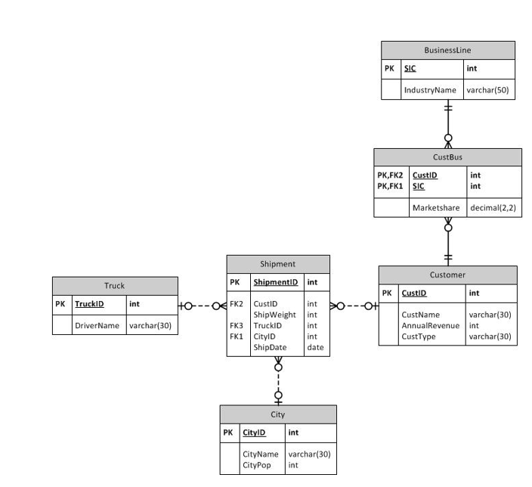
ERD
This is the ERD used to understand the relationships between the tables on slides 3-5

Slide 3
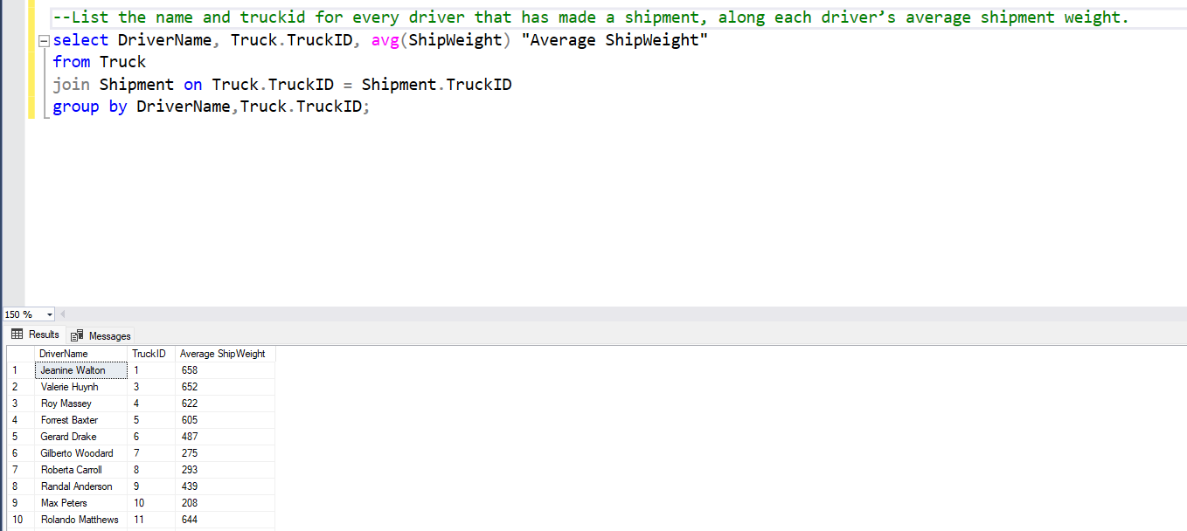

Slide 4
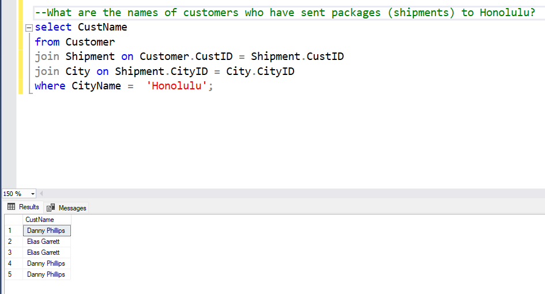

Slide 5
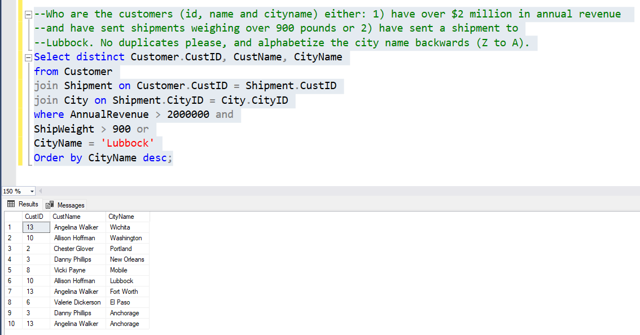

Slide 6
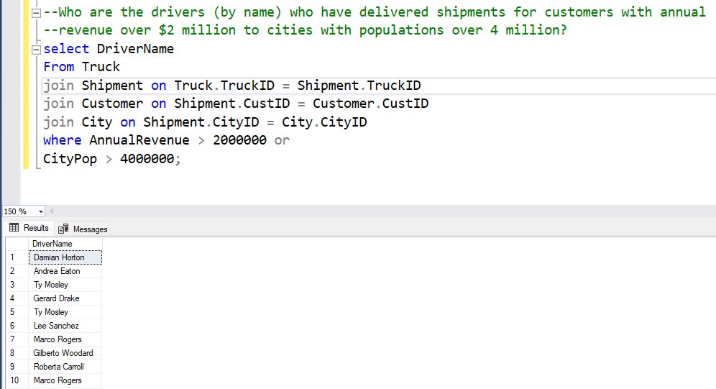

Slide 7
